Slide 1


Forest Carbon Partnership Facility
Certain Implications of Methodological Framework on ERPA General Conditions
FCPF Participant Committee Meeting (PC16)
Geneva, December 13-15, 2013

Slide 2
Overview
  Carbon Fund Methodological Framework: Background & Context
  II. Certain Issues of Methodological Framework
  1.1 Transfer of Legal Title to ERs
  Methodological Framework
  Discussed issues at Pre-PC16 Workshop
  [For further reading: Potential Implications on FCPF ERPA General Conditions]
  2.1 Reversal Management Mechanism
  Methodological Framework
  Discussed issues at Pre-PC16 Workshop
  [For further reading: Potential Implications on FCPF ERPA General Conditions]
2

Slide 3
I
Carbon Fund Methodological Framework: Background & Context
3

Slide 4
FCPF: Two Mechanisms
Readiness Mechanism
READINESS FUND
Capacity
Building
(since 2008)
Carbon Finance Mechanism
CARBON FUND
Emission
Reductions
(since 2011)
Notes:
4

Slide 5
The Carbon Fund
Objectives:
  Pilot ‘performance-based payment system’ for emission reductions (ER) with a view to ensuring equitable benefit sharing
  Conserve biodiversity, and
  Sustain or enhance livelihoods of forest-dependent indigenous peoples and local communities.
Goal:
Pilot about 5 large-scale ER Programs in countries that have made significant progress in REDD+ readiness.
Methodological Framework is a critical component to guide REDD+ countries’ ER Program design to meet Carbon Fund requirements, and assist review by Carbon Fund Participants.

Slide 6


To learn more about the Carbon Fund…

Slide 7
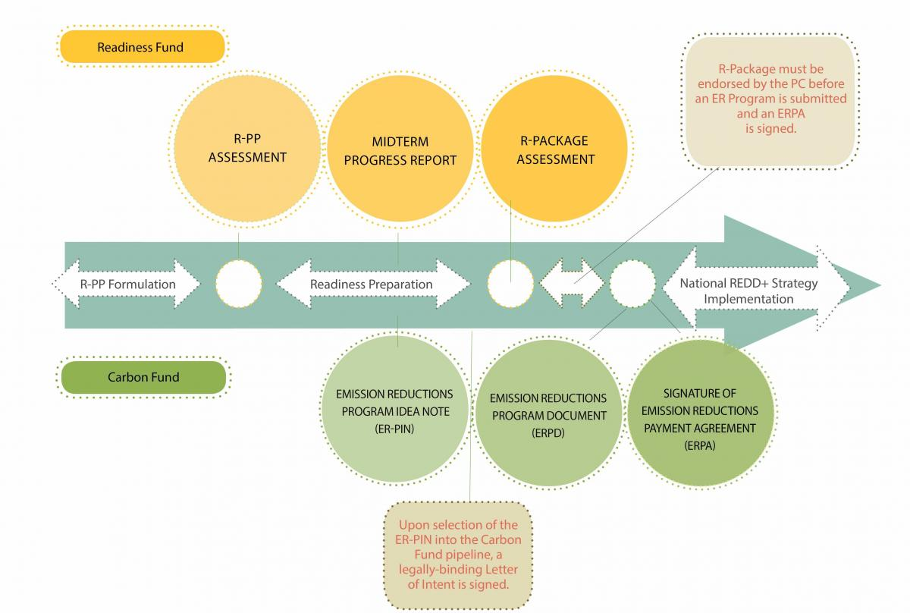
Transition from Readiness Finance to Carbon Finance
Notes:
7

Slide 8
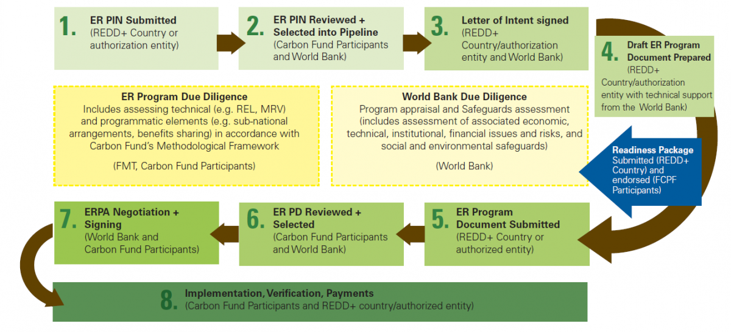
Business Process of the Carbon Fund

Slide 9
Role and Purpose of Methodological Framework
Contains a set of standards that will be used by Carbon Fund Participants to select ER Programs into the Carbon Fund portfolio.
Guide ER Program design, as ER Programs are expected to demonstrate conformity with the Methodological Framework’s criteria and indicators.
Strikes a balance between clear requirements, simplicity (avoiding complex CDM-like methodologies), flexibility (to pilot approaches and encourage innovation), and practicality.
Strives for consistency with emerging policy guidance under United Nations Framework Convention on Climate Change (UNFCCC) and other systems.
Additional operational information and non-binding good practice guidance may be developed to complement the Methodological Framework.

Slide 10
Development of a Methodological Framework
for the FCPF Carbon Fund (per FCPF Charter)
FCPF Participants Committee (PC)
Provided Methodological Principles & Pricing Guidance to Carbon Fund, using PC Working Group
Facility Management Team (FMT) & Technical Advisory Panel (TAP)
• Draft Methodological Framework
• Draft issue papers
Methodological
Framework
Methodological Framework is mandated in FCPF Charter.
Draft Framework builds on Guiding Principles on the key methodological framework for the Carbon Fund, adopted by the FCPF Participants Committee (PC) in June 2012 (Resolution PC/12/2012/3).
Carbon Fund
(decision-making body)
Periodic Updates
Working Group (Carbon fund Participants, Observers + 5 REDD Countries
• Reviews draft products of FMT & TAP and provides advice
REDD Design Forum (Experts + key stakeholders)
• Discussion of approaches & other climate initiatives
10

Slide 11
ER Program Design and Implementation
ER Program
ER Program design informed by Methodological Framework requirements, World Bank due diligence results and other operational and implementation requirements
Methodological Framework
Set of standards (criteria & indicators) for ER Program design
WB Due Diligence on ER Program
WB regional staff + Program entities perform social/environmental/ financial due diligence
Operational Processes & Implementation of ER Program
e.g., Emission Reduction Payment Agreement (ERPA) requirements, verification procedures

Slide 12



Table of Content
- Methodological Framework -
General Approach
Level of Ambition
  Scale and Ambition
Carbon Accounting
  Scope and Methods
  Uncertainties
  Reference Levels
  Measurement, Monitoring and Reporting of Emissions
  Accounting for Displacement (Leakage)
  Accounting for Reversals (Non-Permanence)
  Calculation of Emissions Reductions
Safeguards
  Actions to meet World Bank Safeguards & Support Cancun Safeguards
Sustainable Program Design and Implementation
  Drivers and Land and Resource Tenure Assessments
  Benefit Sharing
  Non-Carbon Benefits
ER Program Transactions
  ERPA Signing Authority and Transfer of Title to ERs
  Data Management and ER Transaction Registries

Slide 13



Slide 14
Time | Action
March 26, 2012 | FCPF Carbon Fund (CF) established Carbon Fund Working Group (CFWG) to develop a Methodological Framework (MF) at CF3 (March 24-26, 2012 in Asuncion, Paraguay)
June 29, 2012 | PC12 endorsed guiding principles on the MF for REDD per PC Resolution (Santa Marta, Colombia)
October 2012 & March, 2013 | Meetings of the CFWG on the MF in Brazzaville and Washington DC
March 21, 2013 | PC14 endorsed ERPA Term Sheet per PC Resolution requesting first draft of the ERPA General Conditions (GCs) by PC15 (June 30-July 1, 2013 in Lombok, Indonesia) with the initial objective of endorsement of ERPA GCs at PC16
June 21-23, 2013 | Meeting of the CFWG on the MF in Paris
June 24-25, 2013 | CF7 meeting in Paris to discuss certain issues of ERPA GCs
June 28, 2013 | Pre-PC15 Workshop (Lombok, Indonesia) on ERPA GCs
June 30-July 1, 2013 | Presentation of first draft of the ERPA GCs at PC15 (Lombok, Indonesia)
  Process of Endorsing ERPA General Conditions
14

Slide 15
Time | Action
October 26-28, 2013 | Meeting of the CFWG on the MF in Oslo
December 5-6 | Meeting of the CFWG on the MF in Paris
December 8-9 | CF8 meeting in Paris; approval of the MF
December 12, 2013 | Pre-PC16 Workshop (Geneva, Switzerland) on Implications of MF on ERPA GCs
December 13-15, 2013 | PC16 (Geneva, Switzerland) on Implications of MF on ERPA GCs
January-March 2014 | Revision of the first draft of the ERPA GCs
March/April 2014 | CF9 meeting
April-June 2014 | Commenting & Review Period for PC members/Observers regarding the revised first draft of the ERPA GCs (potentially with videoconferences)
June 2014 | PC17; endorsement by PC of ERPA GCs
  Process of Endorsing ERPA General Conditions
15

Slide 16
II (1.1)
  Methodological Framework
  - Legal Title to ERs -
16

Slide 17
Transfer of ‘Title to ERs’ (1)
- Methodological Framework -
WHAT IS ‘TITLE TO ERs’?
Means full legal and beneficial title and exclusive right to ERs contracted for under the ERPA.
‘Title to ERs’ relates to ERs only. In particular, it does not relate to any rights, titles or interests to land and territories.
17

Slide 18
Transfer of ‘Title to ERs’ (2)
- Methodological Framework -
HOW TO DEMONSTRATE ABILITY TO TRANSFER TITLE TO ERs?
The ability to transfer Title to ERs may be demonstrated through various means, including:
reference to existing legal and regulatory frameworks,
sub-arrangements with potential land and resource tenure rights-holders (i.e. any agreements, contracts, or other arrangements between the Program Entity and one or more relevant potential rights-holder(s), including those holding legal and customary user rights),
benefit sharing arrangements under the Benefit Sharing Plan.
  ER Program respects (legal and customary) land and resource tenure rights of potential rights-holders, including indigenous peoples.
18

Slide 19
Transfer of ‘Title to ERs’ (3)
- Methodological Framework -
When does the Program Entity have to demonstrate its ability to transfer Title to ERs?
The Program Entity has to demonstrate its ability to transfer Title to ERs at the time of ERPA signature or, at the latest, at the time of transfer of ERs to the Carbon Fund under the ERPA.
The MF requires the ER Program to provide a description in the ER Program Document of the implications of the land and resource regime assessment for the Program Entity’s ability to transfer Title to ERs to the Carbon Fund.
19

Slide 20
Transfer of ‘Title to ERs’ (4)
- Methodological Framework -
Who determines the Program Entity’s ability to transfer Title to ERs?
It will be the responsibility of the Program Entity to demonstrate its ability to transfer Title to ERs to the Carbon Fund.
Whether or not, or to which extent, the Program Entity has succeeded in demonstrating such ability will be assessed by the Carbon Fund on the basis of the information provided by the Program Entity. If needed, the Carbon Fund may, as part of its assessment, request additional external legal advice.
20

Slide 21
Transfer of ‘Title to ERs’ (5)
- Discussed Issues at Pre-PC16 Workshop -
Importance of Program Entity’s ability to transfer ‘Title to ERs’ to the Carbon Fund (during ERPA term & beyond)
Who can be a Program Entity?
Can there be more than one Program Entity?
Can REDD Countries sell or use other ERs (i.e. ERs generated but not sold to the Carbon Fund)?
Does the duration of the FCPF Carbon Fund allow for sufficient time to generate, transfer and pay for transferred title to ERs?
21

Slide 22
II (1.2)
  Potential Implications on FCPF ERPA General Conditions
  - Legal Title to ERs -
  [for further reading]
22

Slide 23
Process of Transfer of ‘Title to ERs’
Prior to ERPA Signature
Seller demonstrates ability to transfer title to ERs
ERPA Signature
Prior to ER Transfer
Seller demonstrates ability to transfer title to ERs & represents and warrants title transfer
ERPA
ER Transfer
After ER Transfer
Event of Default / Action Plan / Remedies
23

Slide 24
Transfer of ‘Title to ERs’ (1)
- Implications on FCPF ERPA General Conditions -
A. PRIOR TO ERPA SIGNATURE
If Carbon Fund determines prior to ERPA signature that Seller did not, fully or partially, demonstrate its ability to transfer Title to ERs:
(Initially anticipated ) ERPA Contract ER volume may be reduced accordingly
Reduction amount may be included in a Call Option
In addition, Seller and Buyer may agree on additional steps:
To make progress on Seller’s ability to transfer Title to such ERs at the time of ER transfer
Such progress could become a milestone for any interim advance payments
However, if prior to ERPA signature the amount of ERs for which Seller cannot demonstrate its ability to transfer Title to ERs is significant, ERPA signature may be postponed until Seller can demonstrate its ability to transfer Title to ERs to an increased amount of ERs.
24

Slide 25
Transfer of ‘Title to ERs’ (2)
- Implications on FCPF ERPA General Conditions -
B. PRIOR TO ER TRANSFER
Under the FCPF ERPA, Seller has to represent and warrant to Buyer at every time of ER transfer that it has transferred Title to ERs free of any third party rights.
If Seller’s ability to transfer unencumbered Title to a portion of ERs is still unclear and/or is contested by any third party or group:
Transfer of unclear or contested ERs is suspended.
Seller has to clarify its ability to transfer Title to all verified ERs within specified time period (e.g. through grievance redress mechanism).
If Seller can clarify its ability to transfer Title to all verified ERs within that specified time period, transfer of ERs will be allowed to proceed.
If Seller cannot clarify its ability to transfer Title to all verified ERs within that specified time period, Buyer may refuse transfer of the affected ERs. As a result, no payment for such affected ERs would become due.
In the latter case, Seller may have its ability to transfer Title to such affected ERs clarified by the time of the next transfer of ERs.
25

Slide 26
Transfer of ‘Title to ERs’ (3)
- Implications on FCPF ERPA General Conditions -
C. AFTER ER TRANSFER
If any third party or group (Contesting Party) contests Seller’s Title to any transferred ERs (Contested ERs), the following procedures could apply:
Unless Seller is able to have Contesting Party’s allegations regarding Title to the Contested ERs assessed and resolved within a specified time period (potentially by using an available grievance redress mechanism under the ER Program), Buyer may request external legal counsel to assess whether or not allegations by Contesting Party appear (on its face (prima facie)) to have merit under domestic law.
If such assessment concludes that Contesting Party’s allegations have no merit, dispute related to the transfer of Title to the Contested ERs would be deemed resolved and no further action would be deemed necessary.
If such assessment concludes that Contesting Party’s allegations do have merit, Contesting Party’s alleged failure to transfer Title to the Contested ERs would be deemed as an Event of Default.
26

Slide 27
Transfer of ‘Title to ERs’ (4)
- Implications on FCPF ERPA General Conditions -
C. AFTER ER TRANSFER (continued)
Such Event of Default could trigger an Action Plan process under which Seller and Buyer agree on plan to cure the Event of Default during a specified time period (e.g. by way of having Seller and Contesting Party agree on including the Contesting Party in the Benefit Sharing Plan in return for an express assignment of Title to the Contested ERs from the Contesting Party to the Seller).
If Seller and Contesting Party succeed in curing the Event of Default no further action would be deemed necessary.
If Seller and Contesting Party fail to cure the Event of Default, Buyer may decide to enter into a new Action Plan with Seller or to exercise the following remedies:
[If a buffer reserve is established for this purpose: Request the release of an amount of ERs deposited in a buffer reserve (equivalent to the amount of Contested ERs) and transfer of such ERs to a registry account nominated by such Contesting Party.]
Exclude the relevant area of land from the ER Program Accounting Area.
If the amount of such Contested ERs equals or exceeds [x]% of the ERPA Contract ER volume, terminate the FCPF ERPA.
27

Slide 28
II (2.1)
  Methodological Framework
  - Reversal Management Mechanism -
28

Slide 29
Reversal Management Mechanism (1)
- Methodological Framework -
What are ‘Reversals’?
Means a situation where the cumulative monitored and verified ERs are less than the currently transferred ERs, i.e., at any point in time more ERs have been transferred than is warranted by the underlying reported and verified results of the ER Program.
Reversals can occur through various events such as, among others, fire, logging, storms, conversion to agriculture etc.
29

Slide 30
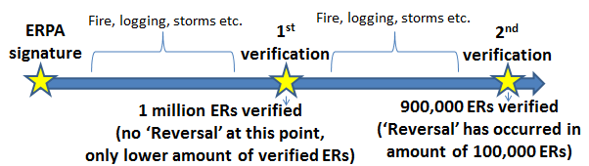
When does a ‘Reversal’ occur ?
30

Slide 31
Reversal Management Mechanism (2)
- Methodological Framework -
How can an ER Program account for Reversals during the term of the ERPA and beyond?
An ER Program has to undertake an assessment of the anthropo-genic and natural risk of Reversals that might affect ERs during the ERPA term and assess, as feasible, the potential risk of Reversals after the end of the ERPA term.
An ER Program also has to demonstrate how effective ER Program design and implementation will mitigate significant risks of Reversals identified in the assessment to the extent possible, and will address the sustainability of ERs, both during the ERPA term and beyond.
31

Slide 32
Reversal Management Mechanism (3)
- Methodological Framework -
How can ER Programs manage the risk of Reversals?
ER Programs need to have in place a reversal management mechanism (e.g., buffer reserve or insurance), that is:
Substantially equivalent to reversal risk mitigation assurance provided by an ER Program CF Buffer (see below), and
appropriate for the ER Program’s assessed level of risk, to fully cover Reversals that may occur during the ERPA term.
While the MF provides for some flexibility on what a reversal management mechanism may look like, the MF envisions an ER Program-specific buffer reserve (ER Program CF Buffer), to be managed by the Carbon Fund, as the default mechanism.
32

Slide 33
Reversal Management Mechanism (4)
- Methodological Framework -
Which risks would be covered by ‘ER Program CF BufferS’?
Risks of Reversals (intentional and un-intentional)
Provided that Seller is in full ERPA compliance
In addition to the ER Program CF Buffer, additional buffer reserves may be provided to manage risks related to uncertainty and disputed Title to transferred ER
33

Slide 34
Reversal Management Mechanism (5)
- Methodological Framework -
How does an ‘ER Program CF Buffer’ work?
In the event the ER Program CF Buffer is the (chosen/default) reversal management mechanism, a certain amount of ERs generated under an ER Program (Buffer ERs) would be deposited in the ER Program CF Buffer.
Such Buffer ERs would not be transferred to the Carbon Fund.
If a Reversal occurs during the ERPA term, an amount of Buffer ERs equivalent to the amount of transferred ERs affected from such Reversal event will be cancelled.
The amount of Buffer ERs to be deposited into the ER Program CF Buffer would be based on a reversal risk assessment and be assessed on a case-by-case basis, but would range from 10-40% of ERs transferred to Carbon Fund at each ER transfer.
34

Slide 35
Reversal Management Mechanism (6)
- Methodological Framework -
How does an ‘ER Program CF Buffer’ work? (continued)
In addition to the risk of Reversals managed through the ER Program CF Buffer, additional buffer reserves may be established to cover additional risks related to uncertainties and/or, if established for this purpose, disputed Title to transferred ERs. Such coverage may require an additional amount of ERs to be deposited in such additional buffer reserves (potentially based on a separate risk assessment).
35

Slide 36
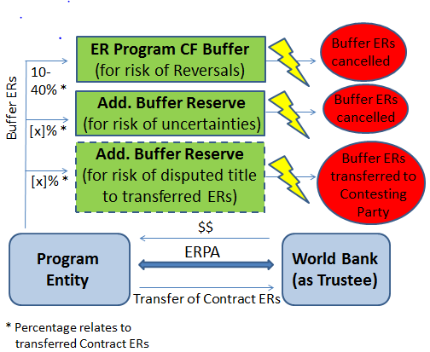
How Buffers May Work
36

Slide 37
Reversal Management Mechanism (7)
- Methodological Framework -
What happens to the ‘Buffer ERs’ at the end of the ERPA term?
At the latest 1 year before ERPA term ends, ER Program should have in place a robust reversal management mechanism or another specified approach that addresses the risk of Reversals beyond the ERPA term (Post-ERPA Mechanism).
If Post-ERPA Mechanism allows for use of buffer ERs, all or a portion of the remaining Buffer ERs in the ER Program CF Buffer at the end of the ERPA term are expected to be transferred to that Post-ERPA Mechanism. If Post-ERPA Mechanism does not allow for the use of buffer ERs, all or a portion of the remaining Buffer ERs in the ER Program CF Buffer will be transferred to a registry account nominated by the Program Entity.
If no Post-ERPA Mechanism is in place 1 year before ERPA term ends, all remaining Buffer ERs in the ER Program CF Buffer will be cancelled.
37

Slide 38
Reversal Management Mechanism (8)
- Methodological Framework -
how are reversals addressed after end of erpa term?
Taking into account that the FCPF is scheduled to terminate on December 31, 2020 and FCPF ERPAs will terminate no later than such date, the World Bank, as trustee of the FCPF Carbon Fund, can only help address/manage risks of Reversals until the end of the FCPF/FCPF ERPAs.
Post-ERPA risks of Reversals, and thereby the continued permanence of transferred ERs, need to be addressed/managed separately.
If a Post-ERPA Mechanism is in place, such mechanism can help address/manage post-ERPA risks of Reversals.
38

Slide 39
Reversal Management Mechanism (9)
- Discussed Issues at Pre-PC16 Workshop -
Importance of a robust Reversal Management Mechanism as well as buffer reserves for other risks (during ERPA term & beyond)
Does the size of the buffer reserves impact on the unit price per transferred ER?
Can a ‘Post-ERPA Mechanism’ allow for the release of certain amounts of Buffer ERs to be used by the REDD Country?
Who bears the risk if a buffer reserve proves to be insufficient to offset covered risk events?
39

Slide 40
II (2.2)
  Potential Implications on FCPF ERPA General Conditions
  - Reversal Management Mechanism -
  [for further reading]
40

Slide 41
Reversal Management Mechanism (1)
- Implications on FCPF ERPA General Conditions -
A. CONDITION PRECEDENT
Unless a reversal management mechanism is in place at ERPA signature, the establishment of a reversal management mechanism could become a condition precedent for the sale and payment obligations under the ERPA to become effective.
B. COVENANTS (GENERAL)
The Seller would have to:
Implement and operate the reversal management mechanism in accordance with best practices
Inform the Trustee if events occur that have the potential to (1) result in a Reversal and/or (2) negatively affect the risk mitigation assurance level provided by such mechanism
Report on the status of the reversal management mechanism periodically
41

Slide 42
Reversal Management Mechanism (2)
- Implications on FCPF ERPA General Conditions -
C. COVENANTS (‘ER PROGRAM CF BUFFER’-SPECIFIC)
If ‘ER Program CF Buffer’ is the reversal management mechanism, at each time of ER transfer, Seller would deposit additional amount of ERs (equivalent to 10-40% of the amount of ERs transferred to the Carbon Fund) into the ER Program CF Buffer as Buffer ERs.
Buffer ERs would be different from and additional to Contract ERs.
No extra payment would be required for Buffer ERs.
The ER Program CF Buffer covers intentional and un-intentional Reversal events, provided that Seller is in full compliance with its ERPA obligations.
42

Slide 43
Reversal Management Mechanism (3)
- Implications on FCPF ERPA General Conditions -
D. REMEDIES
In the event of a Reversal event during the ERPA term, any reversal management mechanism put in place will be used to ensure that validity of any previously transferred ERs remains unaffected.
In case of an ER Program CF Buffer, an amount of Buffer ERs equivalent to the amount of previously transferred ERs that is affected by the Reversal event would be released from the ER Program CF Buffer and be cancelled.
If the reversal management mechanism(s) do not suffice to ensure the continued validity of all previously transferred ERs during the ERPA term, the Buyer may exercise the following remedies:
Terminate the FCPF ERPA
Request payment of incurred Costs/unrecovered advance payments
[Request liquidated damages: e.g. ER unit price X amount of transferred ERs that remain affected by the Reversal event]
43

Slide 44

THANK YOU

